Slide 1
PhET Wave Interference Sim
Learning Goals
Learn to interpret wave representation of water, sound, and light waves
Be able to interpret constructive/destructive interference, recognize nodes/anti-nodes
Learn to measure and predict position of nodes
Be able to interpret fringe patterns (in fringe view or wave view) for light interference on a screen
Design Theory
Develop understanding of increasingly abstract wave phenomena via analogy
Build base for understanding other wave phenomena (e.g. quantum)

Slide 2
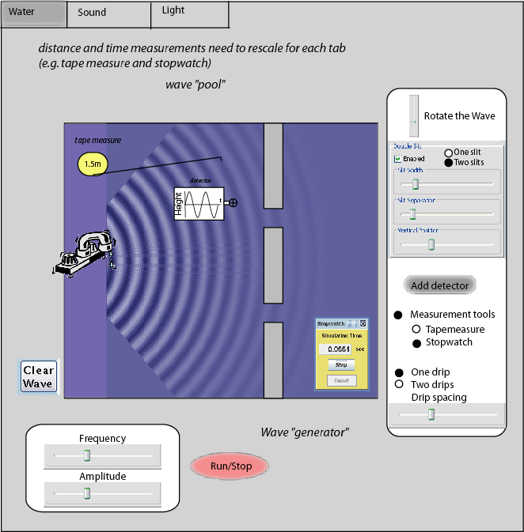
Water wave Tab
Detector shows wave height vs. time at crosshairs (in real time)
Each drip creates
a wave front
Freq sets
drips/sec
Run/stop the faucet

Slide 3
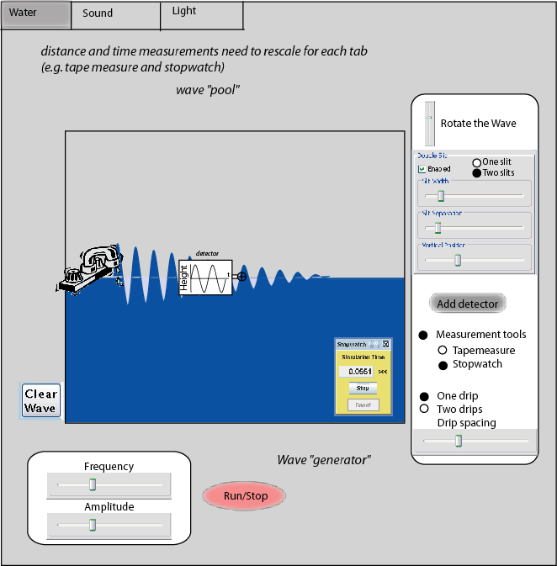

Slide 4
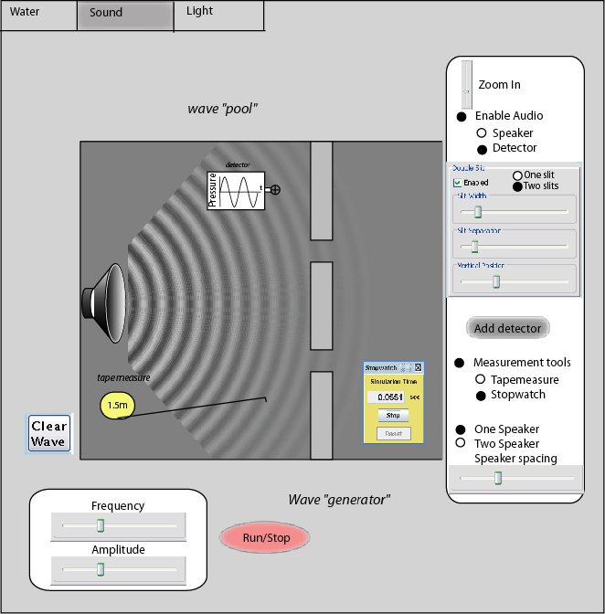
Sound wave Tab
Everything in “wave pool” gets bigger when zooming (see next slide)
3-D speaker
All generators should be 3-D looking if possible
(subtle cuing on 3-D nature of sound)

Slide 5
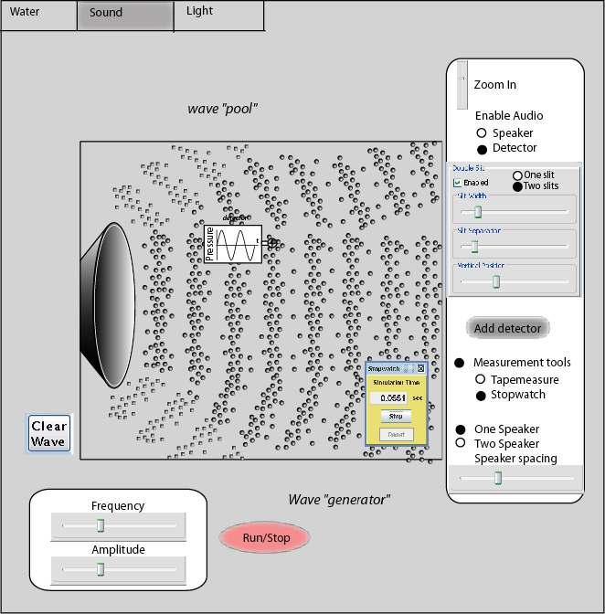

Slide 6
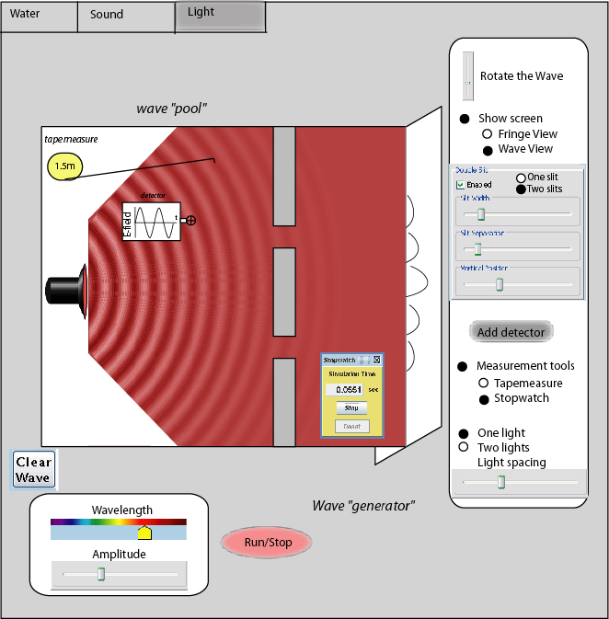
Light wave Tab
Show fringes (light dark pattern) or wave view (as shown) on screen
3-D flashlight
(subtle cuing on 3-D nature of light)
Color of light changes with wavelength slider

Slide 7
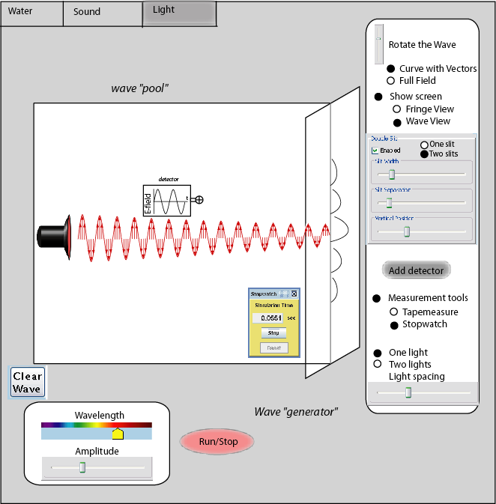
Like in radio waves
Detector should probably read “E-field”

